Slide 1
Cast Iron

Slide 2
Abstract
Pure iron occurs scarcely within a laboratory
To make iron, iron core is converted into pig iron in the blast furnace
Iron, being fragile, is strengthened by impurities thus creating other forms of iron and steel
Its surface corrodes with oxygen to form rust
Casting forms alloys, therefore the name “Cast Iron”
Cast products used have; good castability, strong wear resistance, strong damping power & 3-5 times high tensile strength
Compares to mechanical steel with high damping power, slipping quality and wear resistance

Slide 3
Introduction
Cast iron is an alloy of iron with between 3% and 5% carbon
Has variable silicon and manganese, with traces of Sulphur and phosphorus
Made from reducing iron ore. Molten iron is cast into pigs (ingots)
Pigs along with scrap and alloy components are then melted into cupola stoves, converted into molds for manufacture
Cast iron invented by Chinese (6th Century BC), was manufactured sporadically in Europe (14th Century)
Iron works built in America in 1619, introduced to England in 1500s
Cast iron was cheaper in 1800s and 1900s but replaced in 20th Century

Slide 4
Definition
Cast iron - this is an alloy of iron with between 3% and 5% carbon. It has variable quantities of silicon and manganese, with traces of impurities such as Sulphur and phosphorus

Slide 5
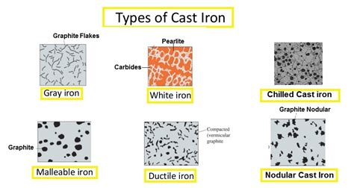
Types of Cast Iron
Malleable cast iron
Gray cast iron
Ductile cast iron
Nodular cast iron
White cast iron
Chilled cast iron

Slide 6
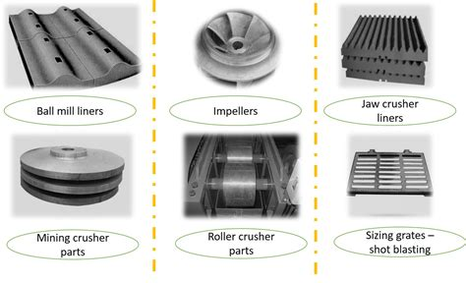
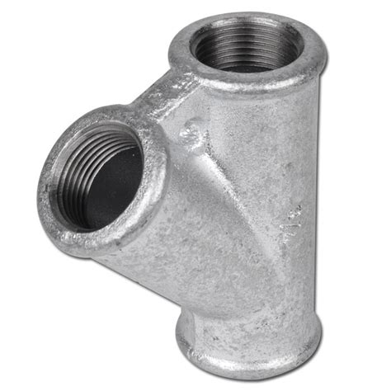
Uses of Cast Iron
Manufacturing pipes and sanitary products e.g. sewer pipes
Manufacture of ship anchors and vehicle parts e.g. bearing caps
Creation of kitchenware, both utensils and pans
Pressure vessels
Valves
Flanges

Slide 7
Process of Manufacturing
Sand casting, a traditional technique, is used by Hargreaves Foundry, supplemented with modern technology and products
Developmental stages are followed in the manufacture
They are:
Preparation
Design
Development
Casting

Slide 8
Types of Processes
Sand casting
Low pressure casting
Die casting
Squeezing die casting
Investment casting
Centrifugal casting
Vacuum die casting
Gravity die casting

Slide 9
Tensile Stress ASTM Standards
Longitudinal tensile features often apply to fiber and its substance
Transverse tensile properties of a unidirectional composite fiber material are linked to the matrix
Tensile properties are often calculated at room temperature
Various study groups have examined the alloys at high temperatures
They obtained results close to functional reference alloys or casting
Figures below display 0.2 yield power, UTS and the fractures elongation calculated by different MIM IN 718 and MIM IN 713 research groups for temperatures 24.8 and 24.9 respectively

Slide 10
Conclusion
Iron is the simplest, useful, essential and one of the most common on earth
Sign of iron is derived from the Latin word “holy metal”
Iron’s very mixable when heated to high temperatures
Chinese were the first to cast iron and use the it
Europeans were first to work iron and molded it under extreme fire

Slide 11
Summary
Pure iron is scarce in the labs
Iron is created by extracting pigs from the iron ore under high temperatures
Iron is mixed with impurities to make it strong
Cast iron is an alloy of iron with between 3% and 5% carbon
Has variable silicon and manganese, with traces of Sulphur and phosphorus
Types of cast iron; malleable, gray, ductile, etc.
Uses of cast iron; pipes, utensils, cooking ware, etc.
Types of manufacturing process; sand, die, low pressure, etc.

